Slide 1
ID/x partners
Machine Learning Model for Credit Risk Prediction
Tio syaifuddin
01-29-2023

Slide 2
Business understanding
The goal is to build a machine learning model that will predict a credit risk.

Slide 3
Analytic approach
The solution for a predictive problem is by using supervised learning model.

Slide 4
Data requirement
We need a data that give a criteria or behavior from the customers who is making a loan/credit request.

Slide 5
Data collection
Dataset is provided by the ID/X partners. Though it is still a raw data with many missing values, inconsistent format, etc. There was a data dictionary too, but some columns are still ambigous (unsure).

Slide 6
Data understanding
Label
There was no label provided by the dataset on the refused loan request. So the label was created based on loan status. Any customer that having a charged off and late payment status were considered as bad applicant (1). Otherwise was count as good applicant (0).
Features
Some columns were chosen as the features by doing exploratory data analysis (EDA) in order to find an apropriate columns. Data visualization mostly spent in this section.

Slide 7
Data preparation
These are outline steps to prepare the data for modeling:
Binning categorical data
Create dummies on categorical data
Standardize numerical data using MinMaxScaler
Split the data onto train (70%) and test (30%)
Balancing the data using SMOTE
Dropping feature having p-value greater than 0.05

Slide 8
modeling
Modeling were created by using 3 machine learning algorithm:
Logistic Regression
Random Forest
XGBoost

Slide 9
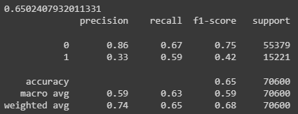
evaluation
Model were evaluated using accuracy, precission, recall, and f1-score. XGBoost was giving the best performance among them by reaching the accuracy of 66%.

Slide 10
Reference
https://github.com/tio14/ID-X-Partners-Credit-Risk.git

